Slide 1

KNOWLEDGE ENGINEERING · ARCHITECTURE REVIEW BOARD
Holding course: the keel and North Star of the enterprise Semantic Fabric
Enterprise access to Claude for ontology engineering, semantic mediation and governance
Executive review · September 29, 2026
Notes:
Framing: this is a tooling request, but the real subject is the architecture it accelerates. The keel is our deterministic semantic foundation; the North Star is where it takes the enterprise. Claude is the force multiplier for engineering both, under the same governance we apply to human work.

Slide 2
THE DECISION
Fund enterprise Claude seats for Knowledge Engineering, proven through a 90-day pilot
What we ask
What it accelerates
What stays the same
Team or Enterprise seats for ontologists, semantic architects and knowledge graph engineers, with SSO, RBAC and no training on our inputs.
Ontology authoring, mapping maintenance under schema drift, and governance artifacts: SHACL shapes, PROV-O envelopes and change logs.
Every generated artifact passes the same peer review, CI/CD, SHACL and reasoner gates as human-authored work.
Semantic Fabric · Keel & North Star
2
Notes:
Lead with the ask so the board knows what it is deciding. Emphasize the third card: this is an accelerator inside our existing controls, not a new path to production.

Slide 3
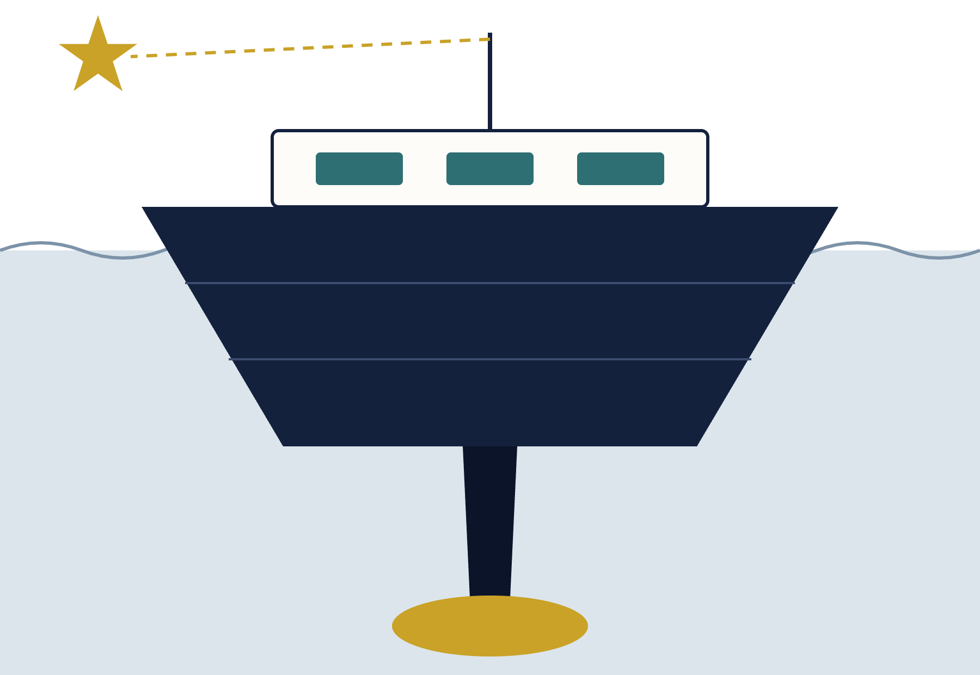
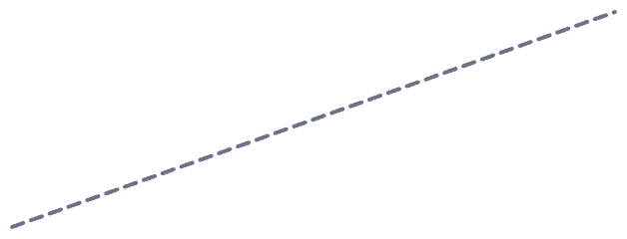
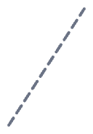

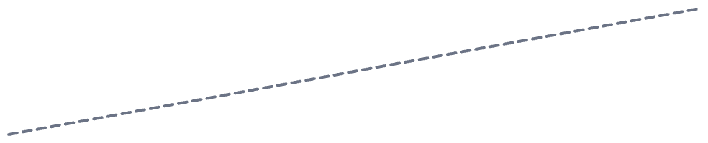
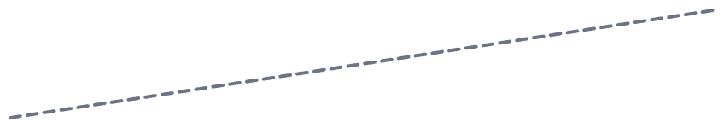
THE KEEL
Deterministic semantics keep the fabric upright as the sea moves
Superstructure · consumers
AI agents, analytics and applications ride high and dry, above all change.
North Star
Waterline · drift
Source schemas and external ontologies change constantly. That is the sea state.
Hull · virtualized mediation
Mapping agents and microservices absorb drift so consumers never feel it.
Keel · materialized graphs
Federated domain ontologies reconciled to one upper ontology: deterministic meaning.
Ballast · semantic governance
SHACL, reasoners, lineage and versioning: the weight that keeps the keel honest.
Semantic Fabric · Keel & North Star
3
Notes:
The keel metaphor: a keel does not steer, it resists being pushed sideways so the vessel can hold a heading. Our materialized ontologies play that role. The hull, our virtualized mediation layer, displaces the drift so consumers stay dry. Governance is the ballast: without it, a bigger ship just capsizes faster. Claude accelerates building every part of this vessel, but it never replaces the ballast.

Slide 4

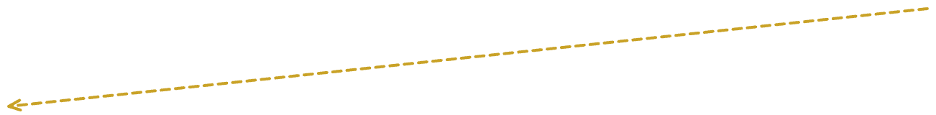
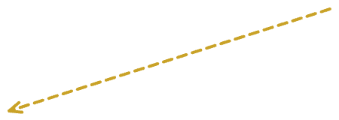
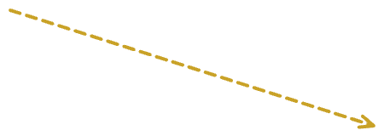
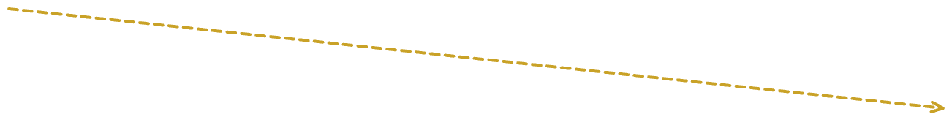

THE NORTH STAR
Every enterprise decision and AI answer rests on governed, traceable, unambiguous meaning
Trustworthy AI
Drift-proof integration
Audit-grade lineage
Weeks, not months
Agents answer from governed semantics; ungated inference never propagates as fact.
Source changes are absorbed in the mediation layer, not in production consumers.
Every axiom, mapping and release carries PROV-O provenance and a change log.
New domain ontologies federate to the upper ontology in weeks.
H1 · 90-day pilot proves the workbench
H2 · federated domains at scale
H3 · self-correcting semantic fabric
Semantic Fabric · Keel & North Star
4
Notes:
The North Star is the heading, not the destination. Four outcomes follow from it. The horizons show sequencing: H1 is the only commitment in this request; H2 and H3 are the direction the keel lets us hold.

Slide 5


ARCHITECTURE
Three layers, one governance spine, one engineering workbench
Consumers · AI agents · analytics · applications
Claude workbench
Virtualized graph & mediation layer
Governance spine
Mapping agents
Semantic microservices
R2RML · RML mappings
Drafts ontologies, mappings, SHACL shapes, SPARQL and agent prompts.
SHACL validation
DL reasoner checks
Impact simulation
Peer review · CI/CD
PROV-O lineage
Materialized knowledge graphs
Proposes. Never publishes.
Upper / unifying ontology
Domain ontology
Domain ontology
Domain ontology
Operational sources · relational · NoSQL · external ontologies
Semantic Fabric · Keel & North Star
5
Notes:
Read bottom to top: sources feed the mediation layer, which binds them to canonical IRIs in the materialized graphs; consumers only ever see the canonical semantics. Claude sits on the left as the engineering workbench feeding drafts into both layers. Governance sits on the right as the gate every change passes through.

Slide 6

DRIFT INSULATION
When a source schema changes, consumers never notice
01
02
03
04
05
Drift detected
Claude drafts the delta
Deterministic gates
Engineer approves
Registry publishes
Source v2 renames and retypes fields behind an RDF endpoint.
Peer review in Git; nothing merges on model output alone.
New mapping version with lineage; canonical IRIs unchanged.
Structural diff plus updated R2RML/RML rules, with rationale.
SHACL shapes, reasoner consistency and regression SPARQL pass.
Today · point-to-point ETL
Target · mediated fabric
One source change breaks many hand-coded mappings; fixes are reactive and found in production.
One governed mapping update; every consumer keeps querying the same canonical IRIs.
Semantic Fabric · Keel & North Star
6
Notes:
This is the hull doing its job. Note step 2 is the only step Claude owns, and it produces a draft. Steps 3 and 4 are deterministic gates and human judgment. The consumer-facing contract, the canonical IRIs, never moves.

Slide 7


RELEASE LIFECYCLE
Claude proposes; deterministic gates decide
Author axioms
Draft SHACL
Simulate impact
Release metadata
Claude drafts
SKOS / OWL 2 DL from regs and data dictionaries
Node and property shapes from requirements
Blast radius on queries, shapes, inferences
PROV-O, Dublin Core, change log
Syntax & reasoner
SHACL validation
Regression & review
Versioned publish
Gates decide
Parse, then HermiT / Pellet satisfiability
Run against synthetic test triples
SPARQL suite plus peer review in Git
CI/CD promotes to the triple store
Invariant: no model output reaches the triple store without passing every deterministic gate and a human reviewer.
Semantic Fabric · Keel & North Star
7
Notes:
Two lanes, alternating. Every draft in the teal lane drops into a gold gate before the next draft begins. This is how we prevent deterministic propagation over ungated inference: uncertainty from the model never gets laundered into a published axiom or mapping.

Slide 8
VALUE
Where the time goes today, and what changes
Capability | Business impact | Today | With Claude
Materialized knowledge graphs | Data and AI grounded in deterministic business semantics | Manual taxonomy and ontology authoring bottlenecks federation | Target: 60–75% shorter authoring and refactoring cycles
Virtualized graph & mapping layer | Consumers protected from source drift without ETL rewrites | Brittle point-to-point mappings break on source change | Mapping drafts and drift analysis by semantic agents
Semantic governance | Audit-grade traceability and change-impact simulation | Reactive breakages; manual change-log reconciliation | Semantic diffing, regression tests, blast-radius analysis
All figures are hypotheses. The pilot measures them against today's baselines before any wider rollout.
Semantic Fabric · Keel & North Star
8
Notes:
The 60 to 75 percent figure is our target from the business case, not a measured result. Present it as the hypothesis the pilot will confirm or correct.

Slide 9
FIT FOR PURPOSE
Why this workbench fits formal knowledge engineering
Long context
Formal syntax fluency
Whole ontology modules, BFO / DOLCE / FIBO foundations and SHACL catalogues in one session for coherence checks.
Turtle, SPARQL 1.1, SHACL and OWL 2 Manchester syntax, drafted for our validators to confirm.
Artifacts workbench
Project workspaces
Ontology, shapes and test queries inspected and iterated side by side.
Upper ontology, IRI minting rules and governance policies pinned for every session.
Semantic Fabric · Keel & North Star
9
Notes:
Keep the claim modest: fluency means good drafts, and our validators remain the judge of correctness. The workspace point matters most for consistency: every engineer starts from the same upper ontology and naming rules.

Slide 10



SECURITY & GOVERNANCE
Guardrails that hold regardless of who authors the change
Access
Data
Review
Team or Enterprise tier with SSO/SAML and RBAC. Commercial terms that inputs and outputs are not used for training, confirmed in contract.
Abstract models, axioms, schemas, metadata and synthetic test triples only. No production PII, PHI or customer transactions.
All SPARQL, SHACL and ontology output goes through peer review, Git CI/CD and automated reasoning before deployment.
Semantic Fabric · Keel & North Star
10
Notes:
Security will ask about data residency and retention; have the enterprise terms ready. The data-handling rule is the strongest control: we work on models and synthetic triples, not production data.

Slide 11
90-DAY PILOT
Three phases, three measures, one go/no-go
Days 0–15
Days 15–60
Days 60–90
Set up
Run live workflows
Measure and read out
Seats, SSO, Project Workspaces seeded
Authoring, drift remediation and SHACL generation on real (non-PII) models through the normal gates
Compare against baselines; readout to this board
Authoring cycle time
Mapping turnaround
Pre-release defects
Baseline [__ weeks] · target [__ weeks]
Baseline [__ days] · target [__ days]
Baseline [__ per build] · target [__]
Semantic Fabric · Keel & North Star
11
Notes:
Phase boundaries are a proposal. Fill in baselines from the last two or three release cycles before the review so the targets are credible.

Slide 12

DECISION REQUESTED
Four approvals to set the heading
1
Approve [__] seats on the [Team / Enterprise] tier for the Knowledge Engineering team
2
Name a pilot sponsor and an information security reviewer
3
Endorse the workspace baseline: upper ontology, IRI minting rules, SHACL and SPARQL templates
4
Agree the day-90 go/no-go criteria for wider rollout
Notes:
Close on the ask. The keel is already being built; this request makes it faster to build and safer to maintain, while the North Star stays fixed.

